Slide 1

Review Sense Extracting Insights from Customers Feedback
Team : InsightIQ

Slide 2

Our Team
Geetha Sri
Bharath
Monisha
Shameera Shaik
Aryan Singh
Mentor : Mukilan Selvaraj

Slide 3

Introduction
Businesses struggle to extract specific insights from thousands of customer reviews
AI-powered platform that identifies WHAT customers love/hate in products
Key Value:
Pinpoint specific product aspects (battery, camera, service)
Quantify sentiment for each aspect
Visualize insights through interactive dashboards
Impact: 80% faster insights vs manual analysis

Slide 4
Technology Stack
Backend & AI
Framework: Flask (Python) NLP Engine: spaCy + Hugging Face Transformers Database: SQLAlchemy with SQLite/MySQL Authentication: JWT & Session-based
Frontend & UI
Templates: Jinja2 with Bootstrap Visualization: Chart.js & Custom CSS File Processing: Pandas
Deployment
Containerization: Docker Version Control: Git Configuration: Environment Variables

Slide 5
System Architecture
Client Browser
Flask Server
Database SQLite
NLP Engine
spaCy
Transformers
Aspect Extraction

Slide 6
Key Features
User Authentication & Management
Review Processing Pipeline
AI Analysis Engine
Visualization Dashboard
6

Slide 7
AI/ML Implementations
Text Preprocessing
Tokenization & cleaning Stop-word removal Sentence segmentation
Aspect Extraction
Rule-based keyword matching Dependency parsing for context Custom aspect categories
Sentiment Analysis
Hugging Face transformer models Aspect-level sentiment scoring Confidence metrics

Slide 8
Key Achievements
2
3
4
1
Milestone 1: Foundation
User authentication system
Database setup with migrations
Basic web interface
Milestone 2:Core NLP
Text preprocessing pipeline
Overall sentiment analysis
Review management
Milestone 3: Advanced Features
Aspect extraction engine
Aspect-level sentiment analysis
Interactive visualization
Milestone 4: Production Ready
Admin dashboard
Docker containerization
Performance optimization

Slide 9
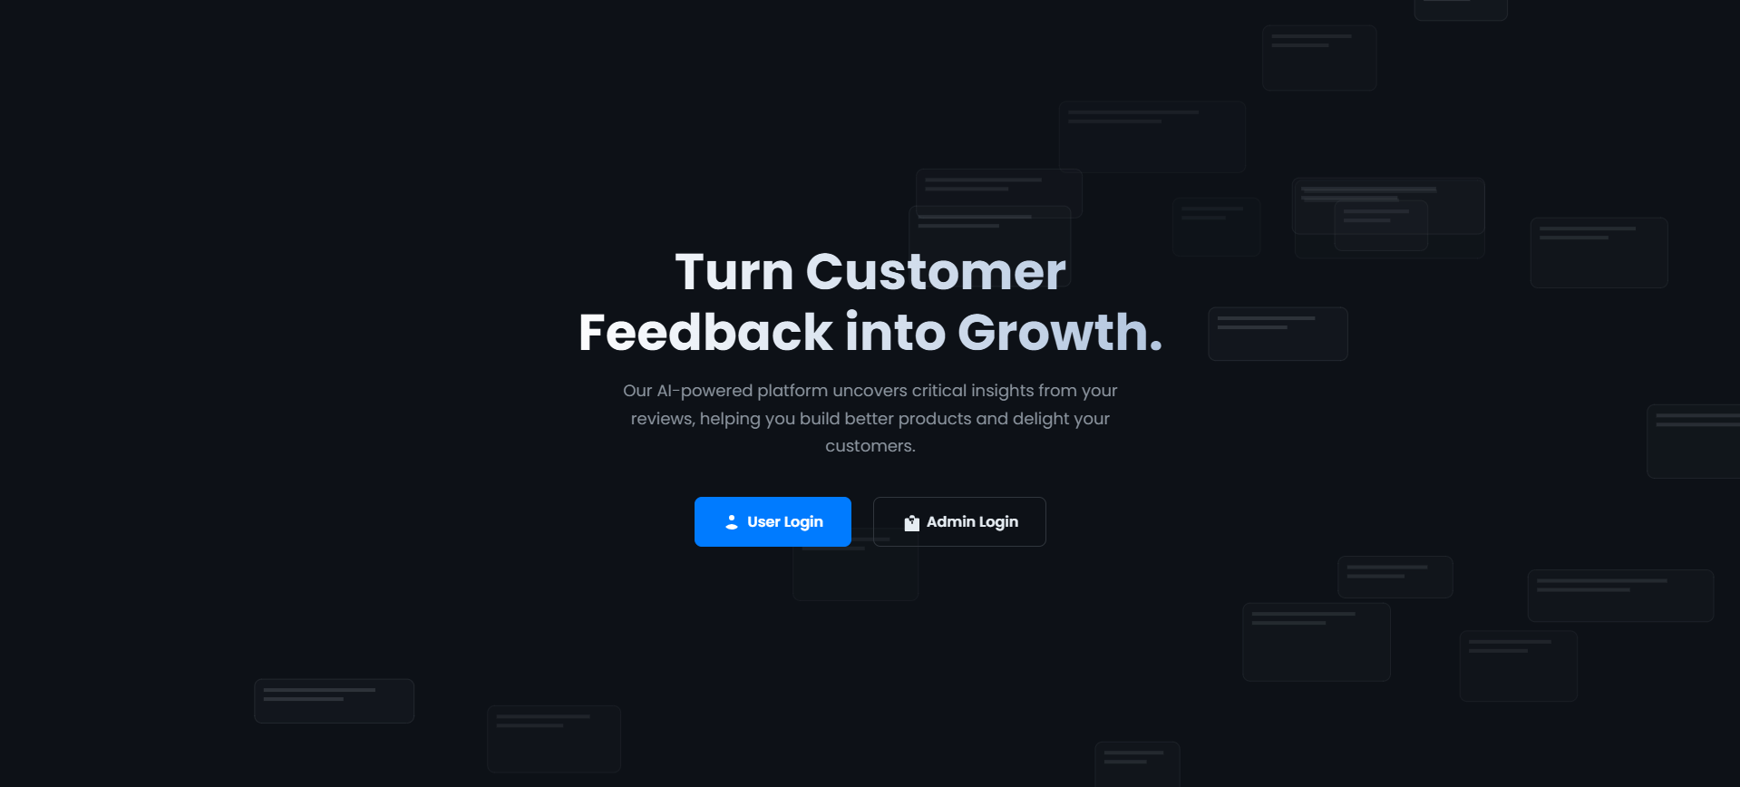
Landing page

Slide 10
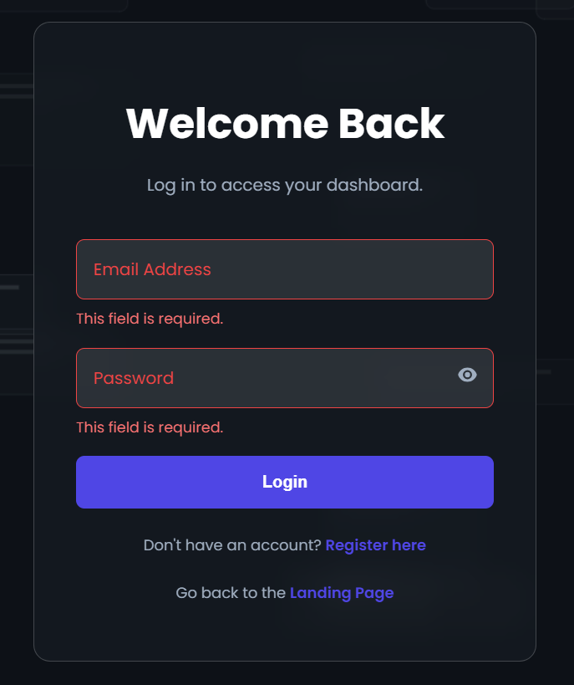
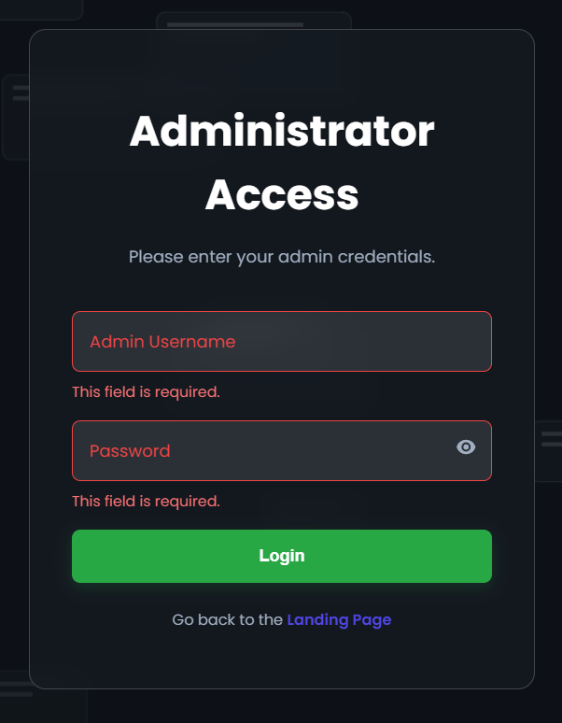
User and Admin Login page

Slide 11
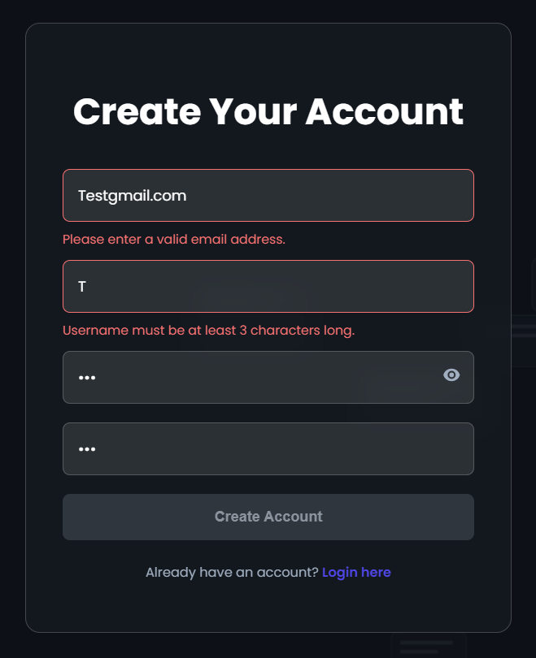
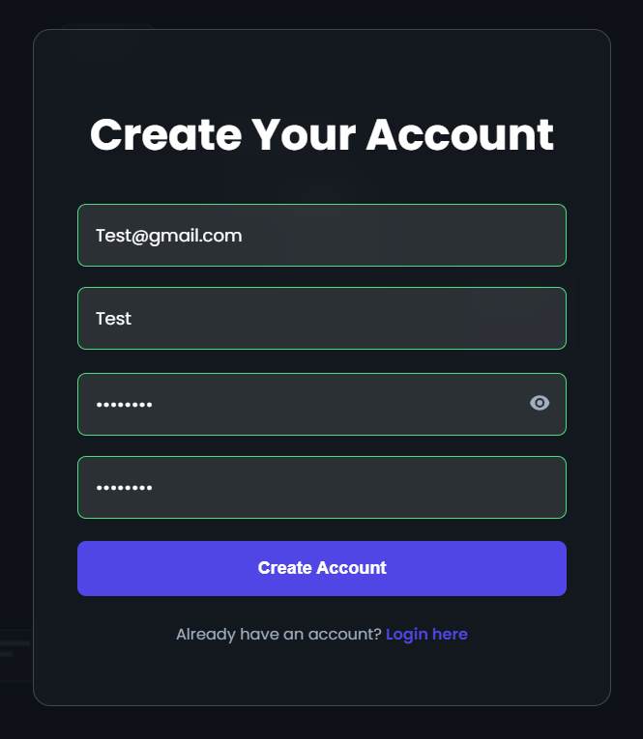
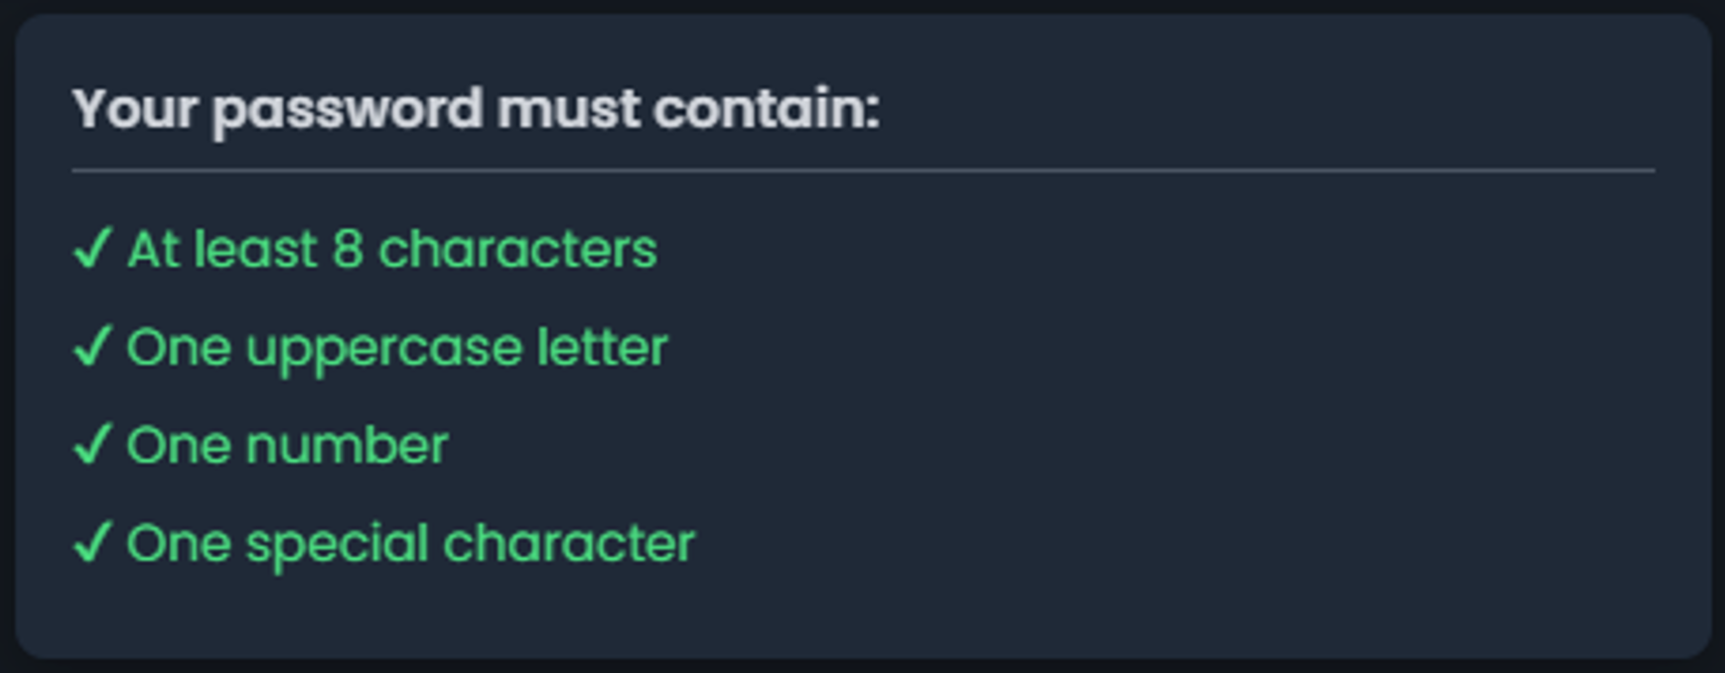
User Registration Validation
Valid inputs unlock the Create Account button.

Slide 12
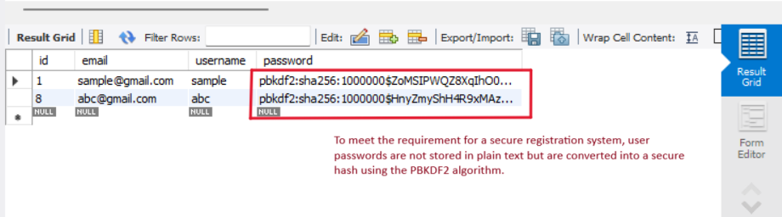
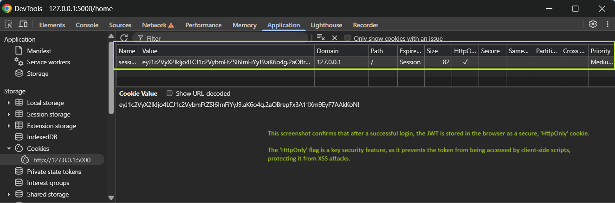
Password protection and JWT session management

Slide 13
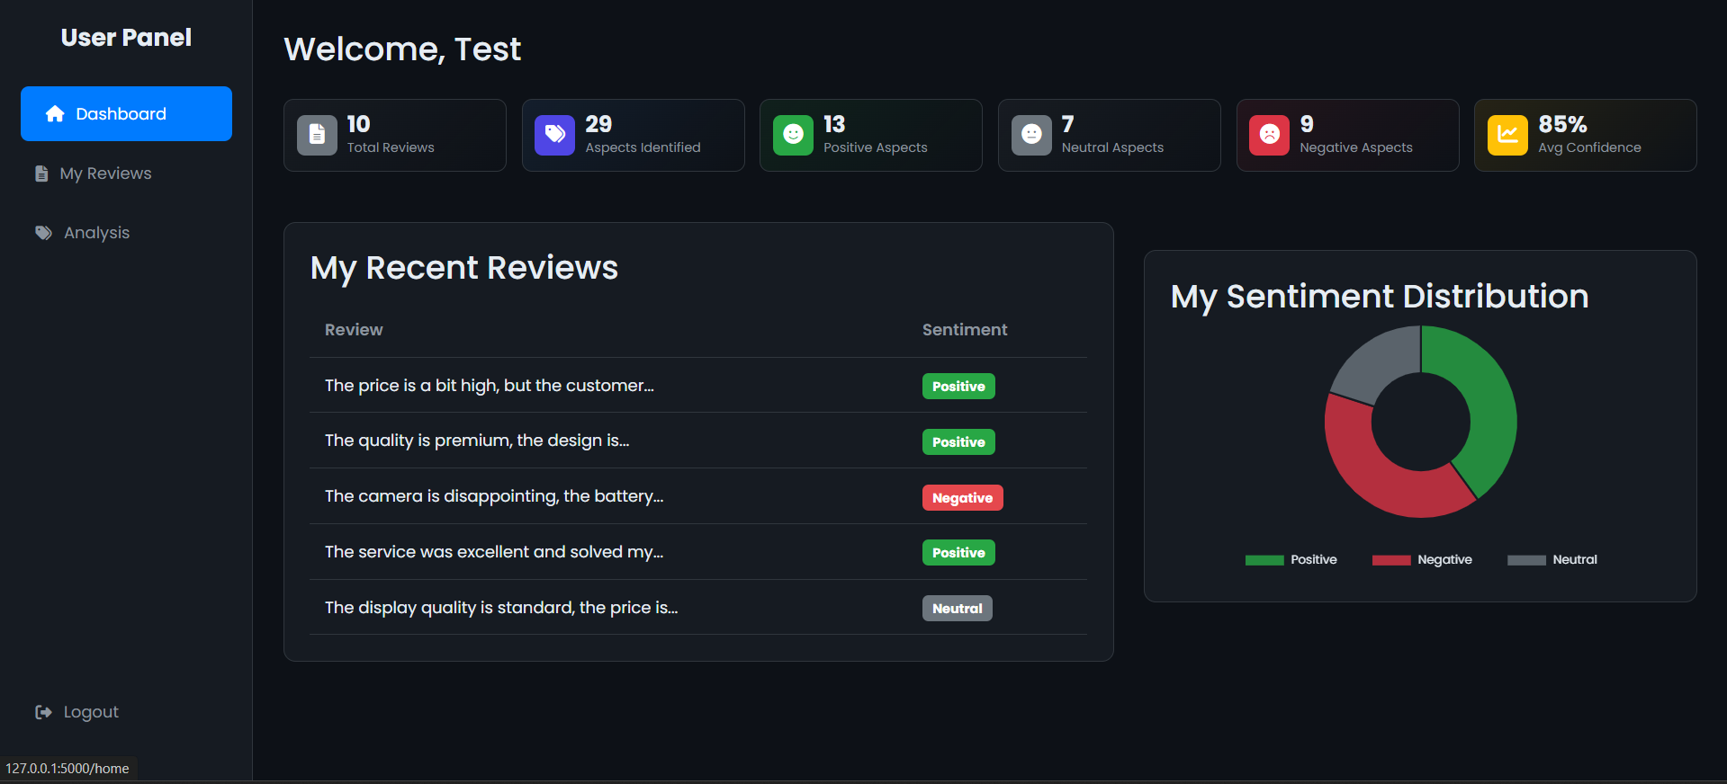
User Dashboard

Slide 14
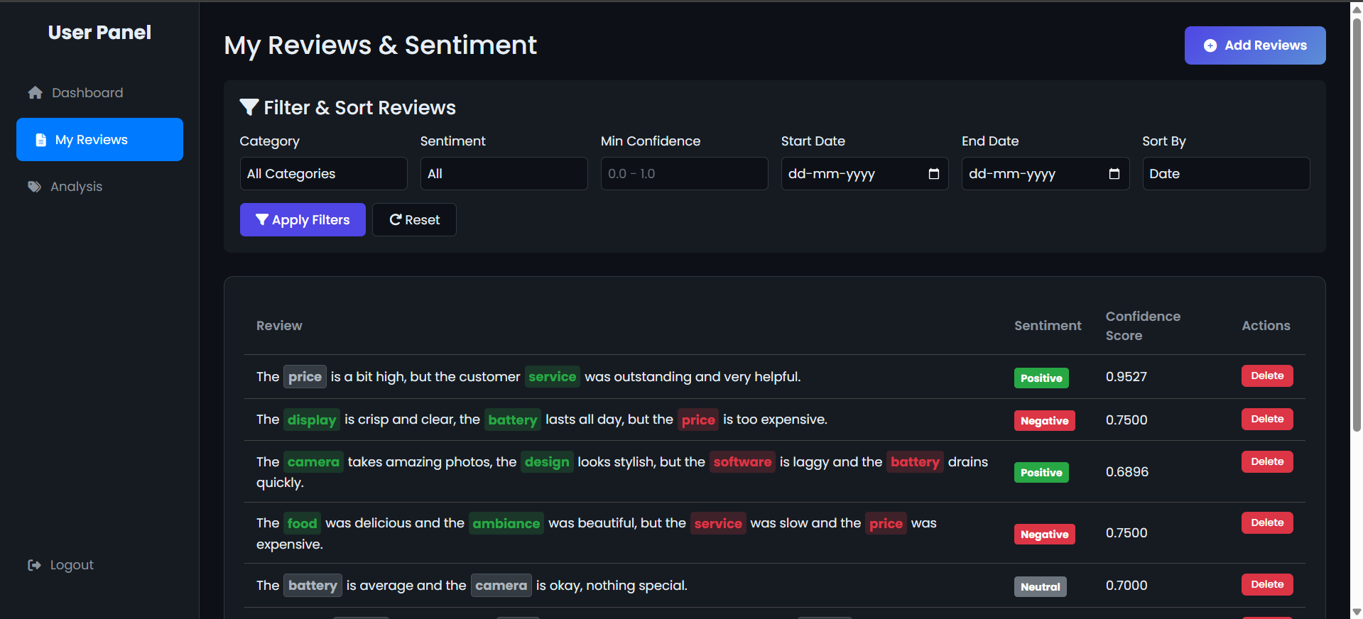
User Reviews with Sentiment

Slide 15
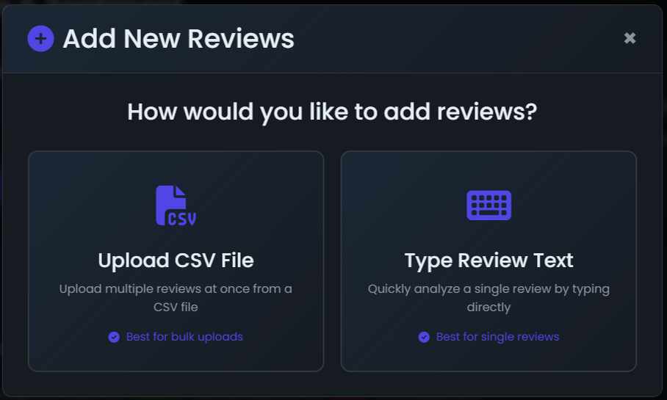
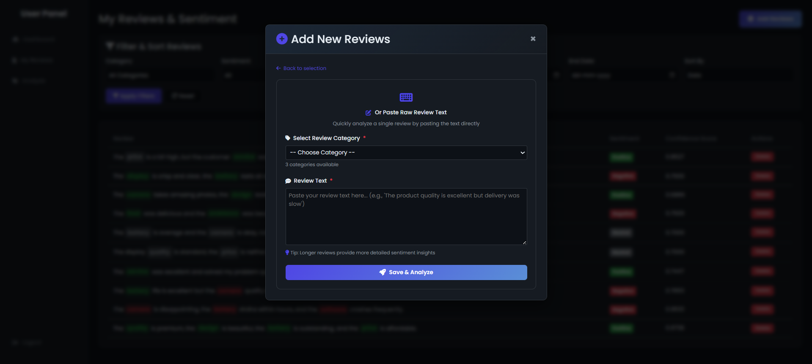
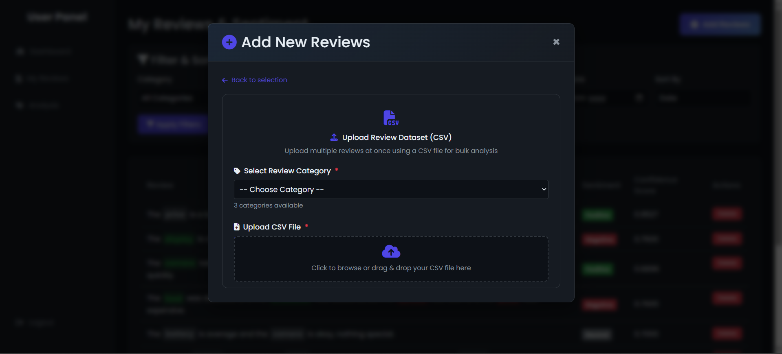
Add Reviews

Slide 16
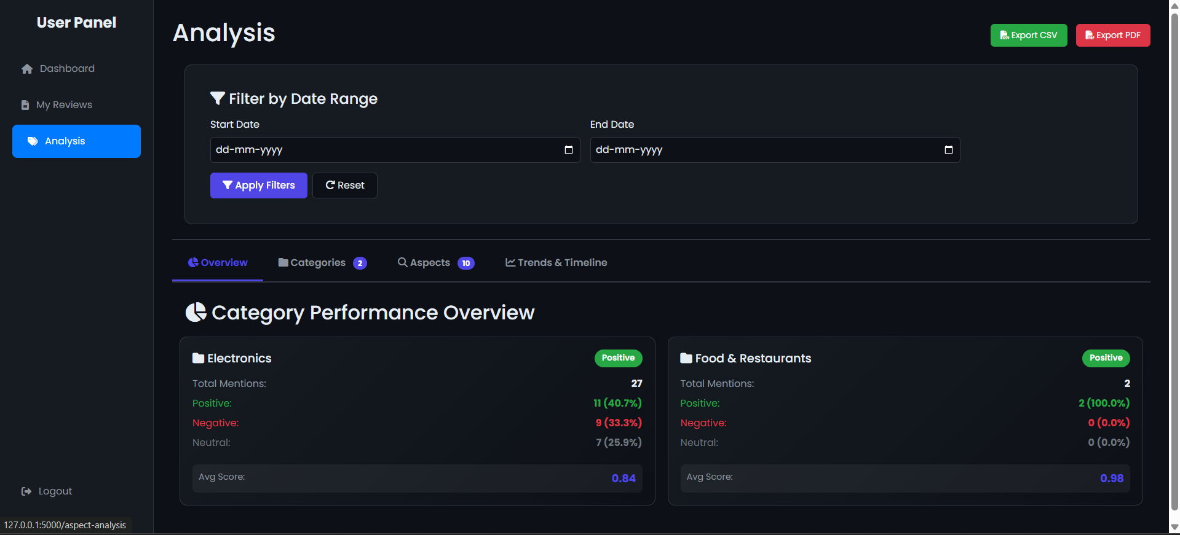
Analysis Page

Slide 17
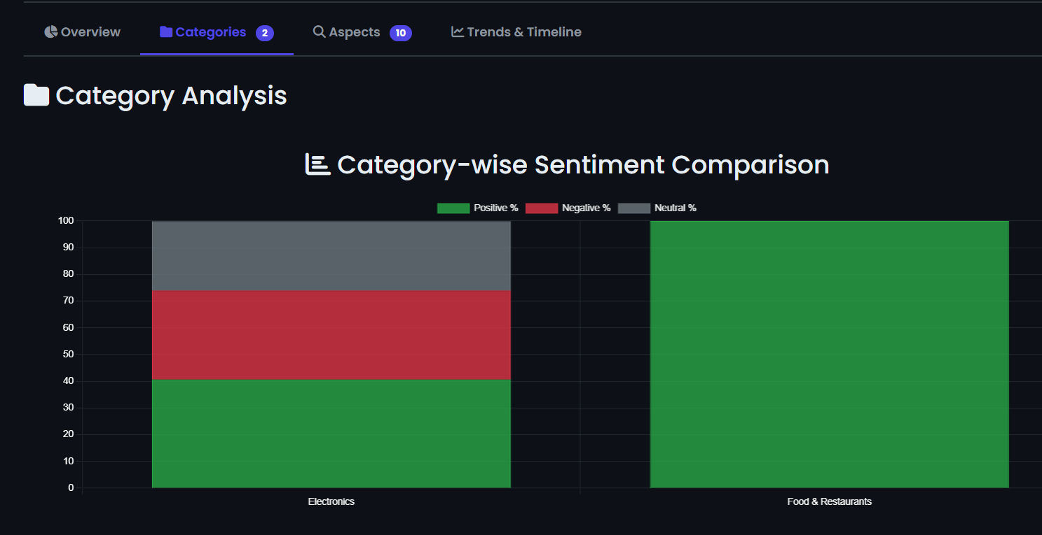
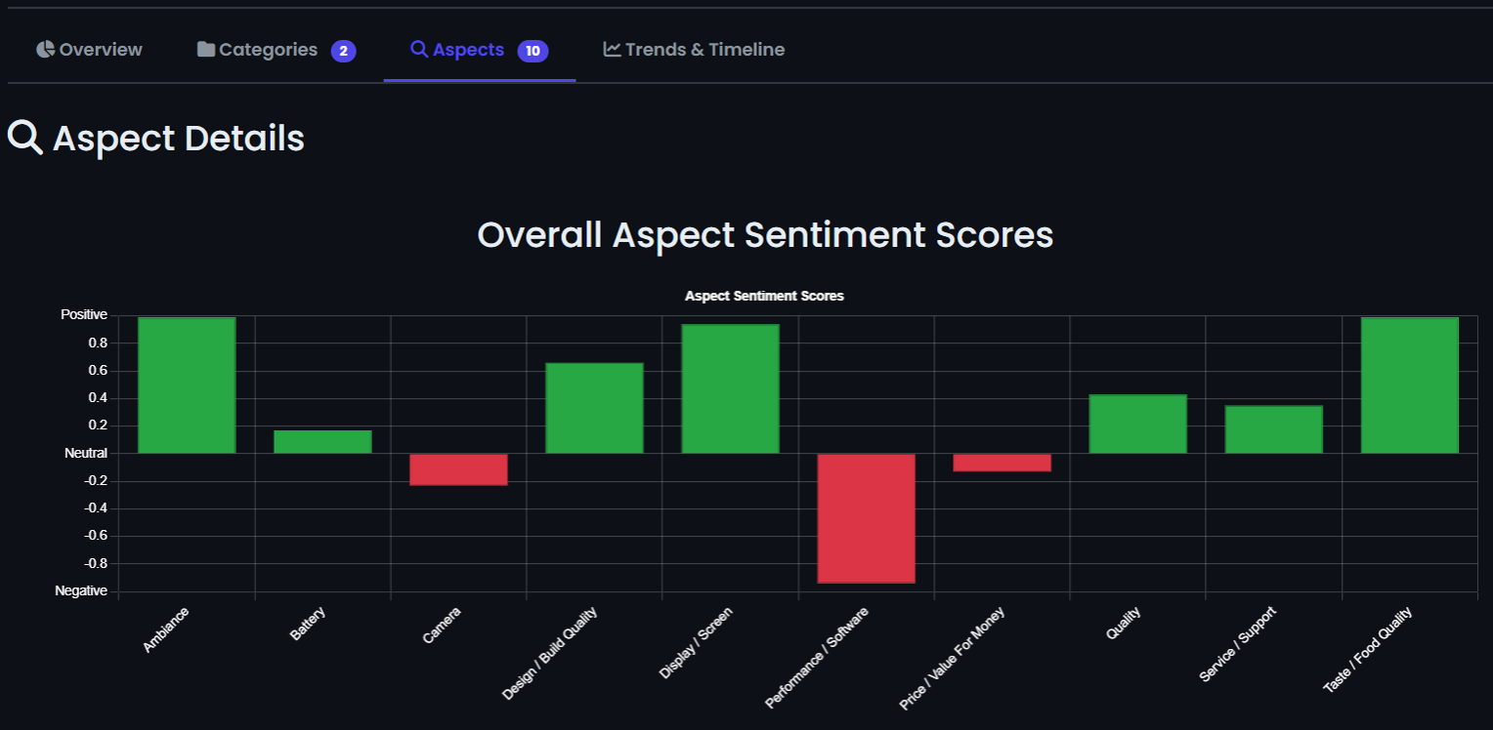
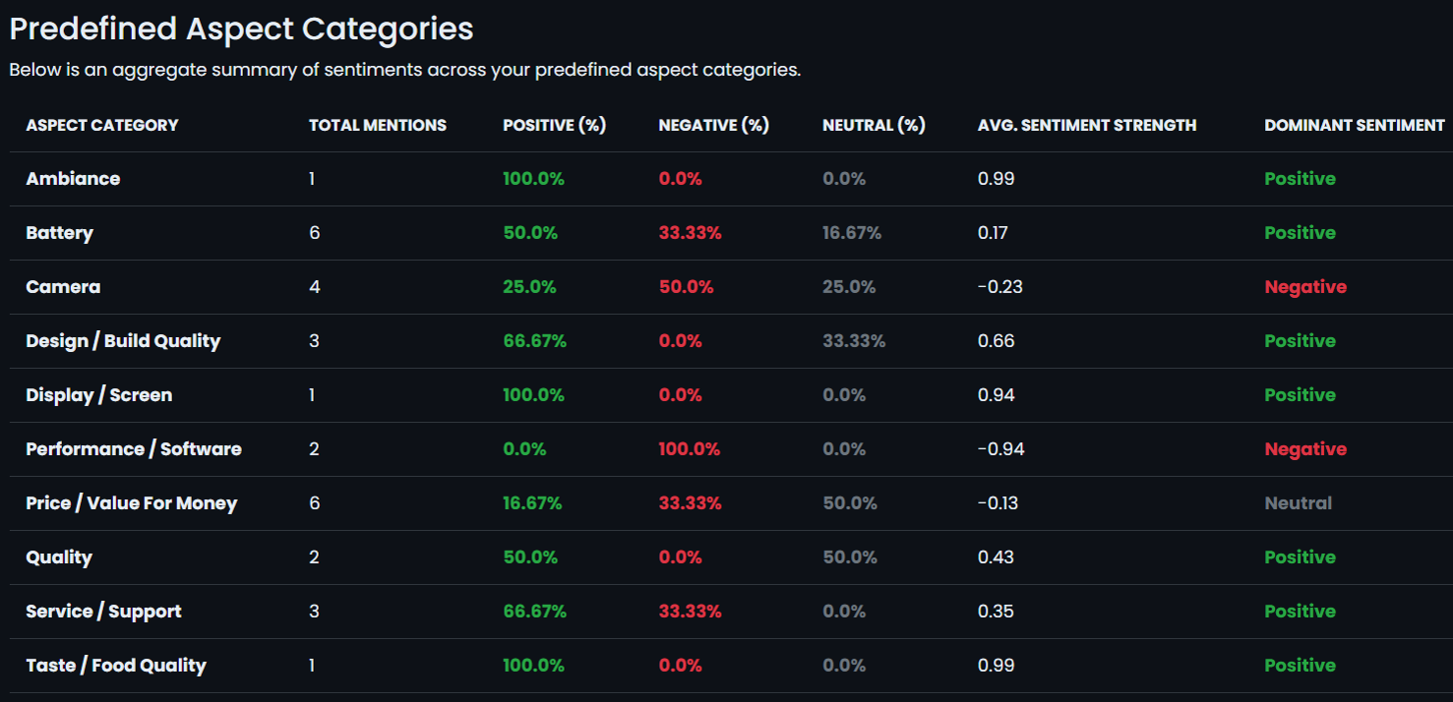
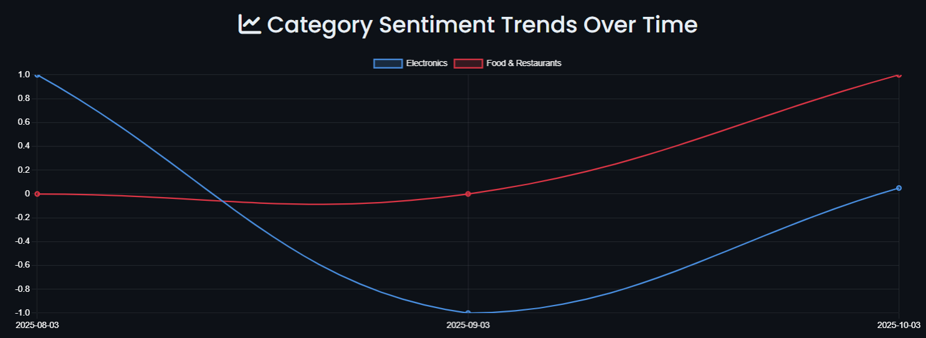
Categories
Aspects

Slide 18
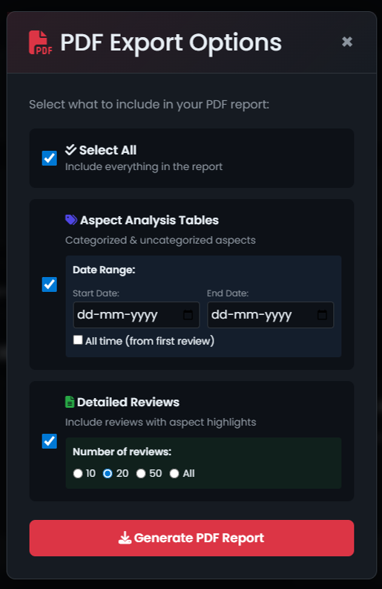
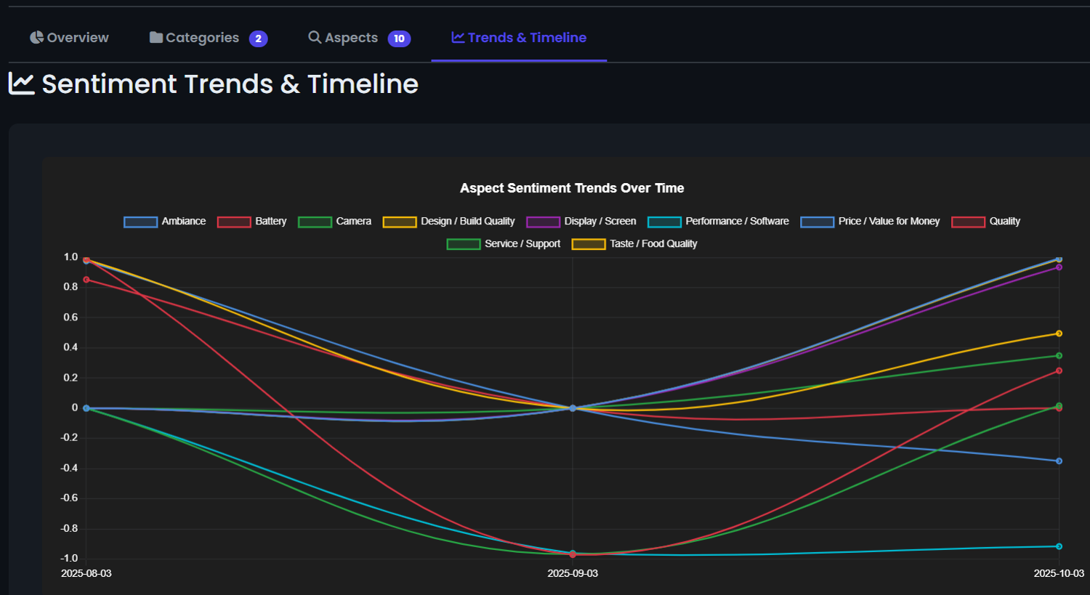
PDF Export Options
Sentiment Trends & Timeline

Slide 19
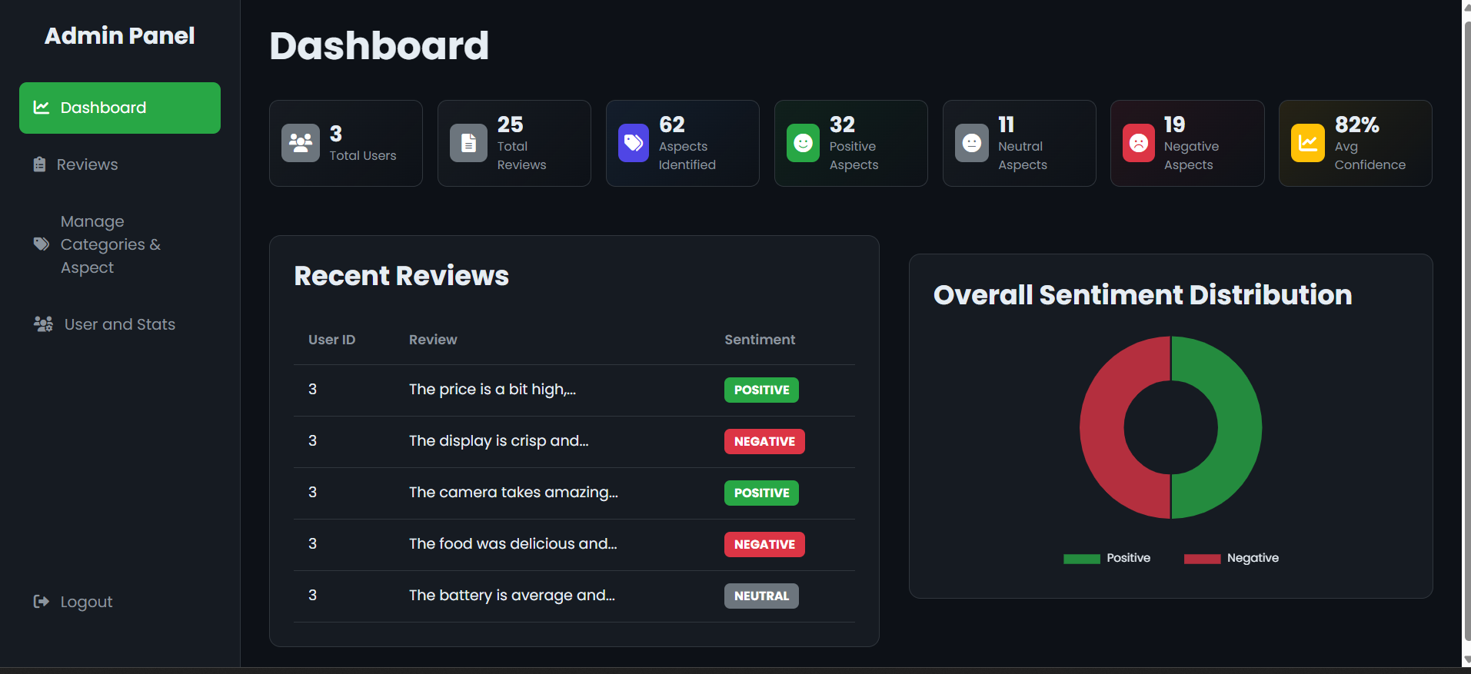
Admin Dashboard

Slide 20
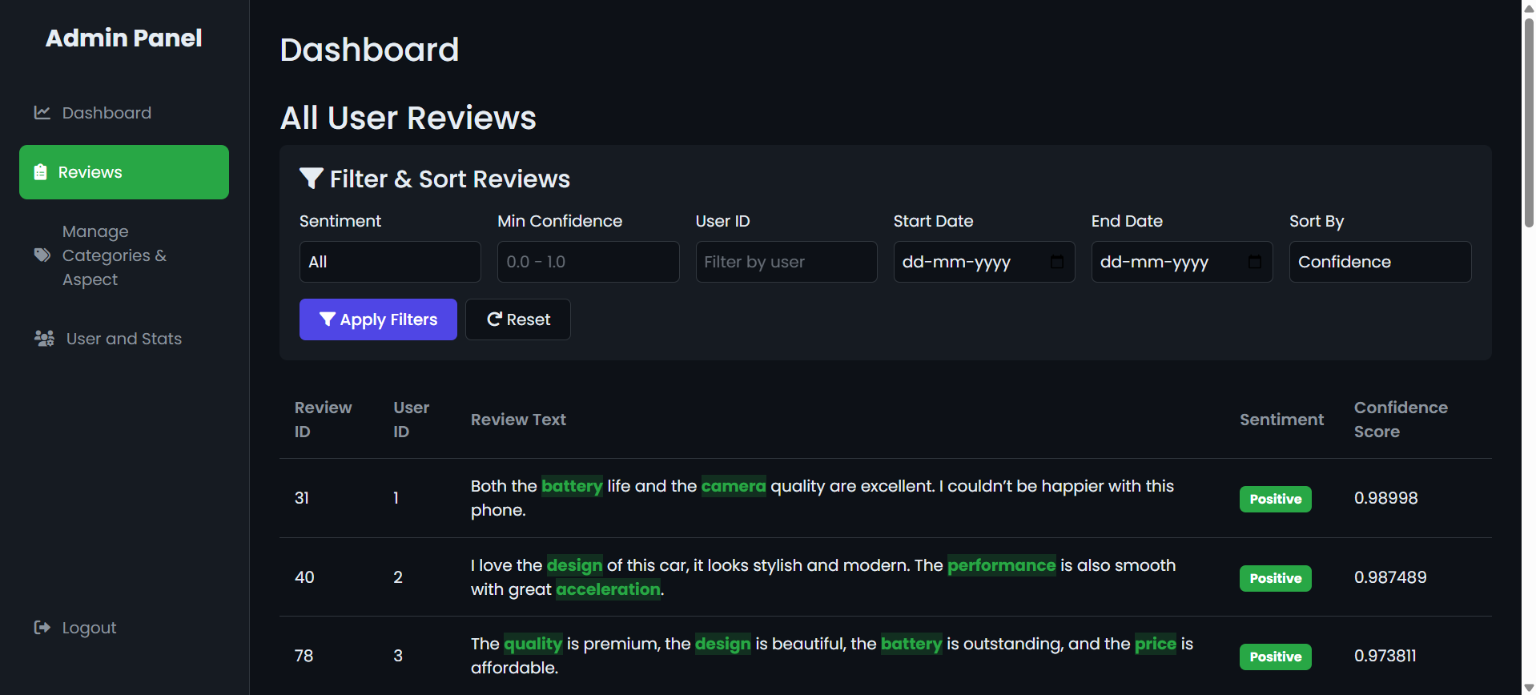

All User Reviews with Sentiment

Slide 21
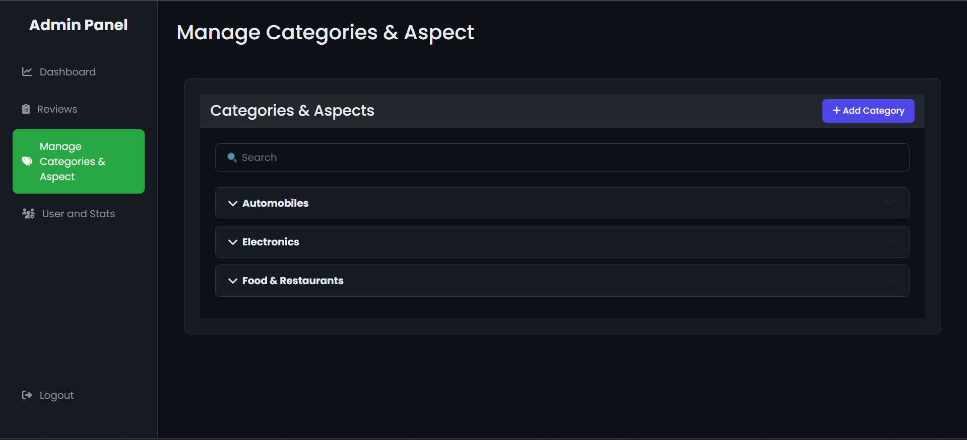
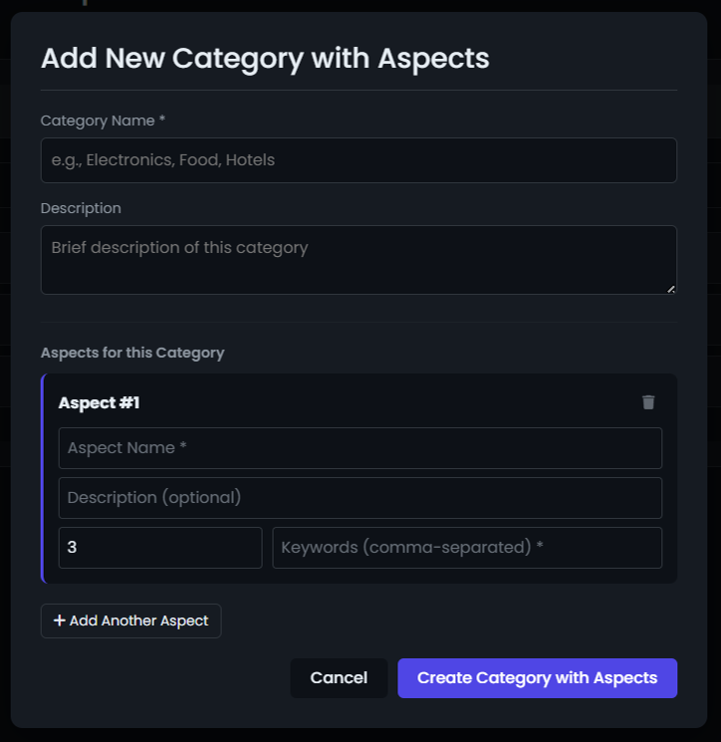
Manage Categories & Aspect
Add New Category with Aspects

Slide 22
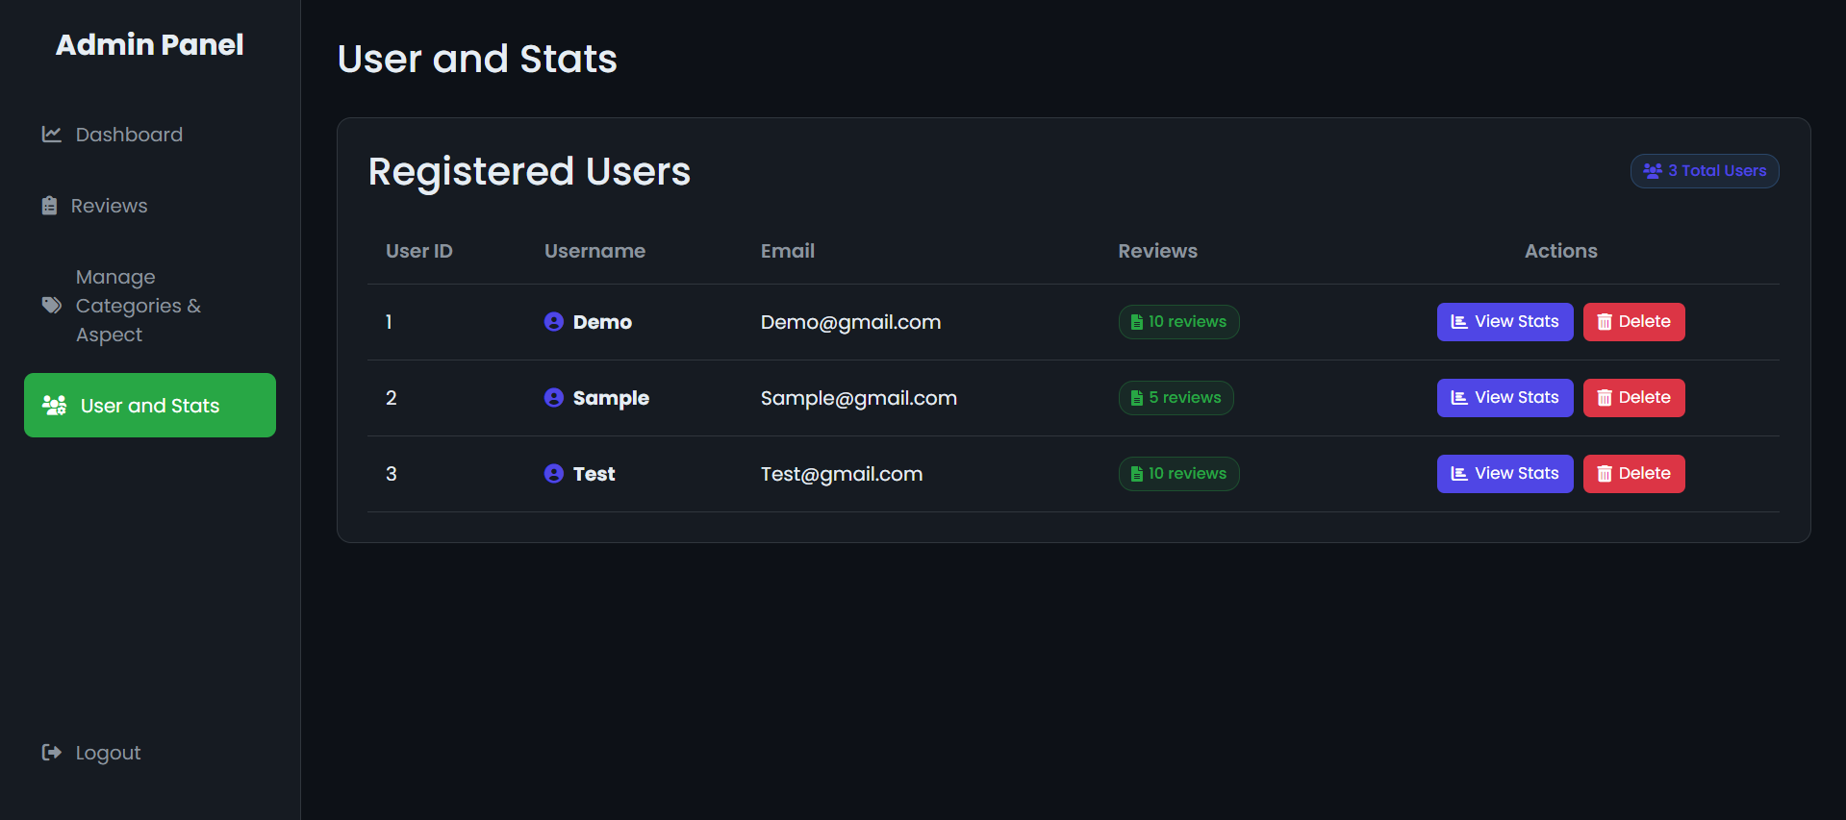
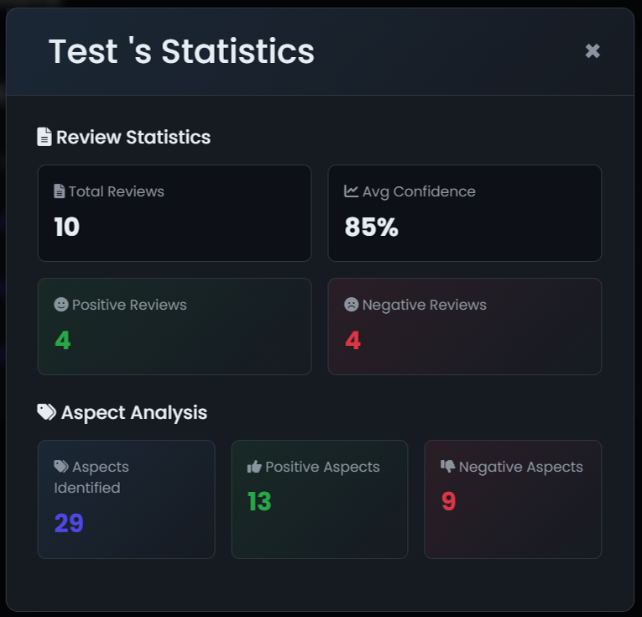
User and Stats
User's Statistics

Slide 23
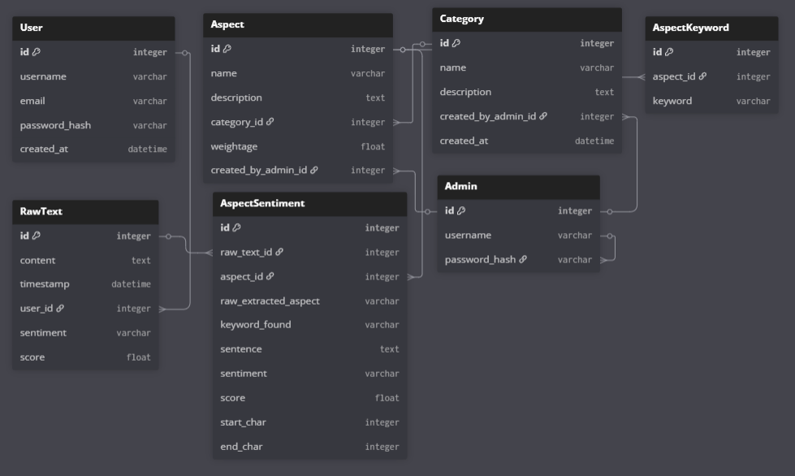
Database Schema

Slide 24
Technical Challenges & Solutions
Challenge 1: Aspect Extraction Accuracy
Solution: Combined rule-based + dependency parsing approach
Challenge 2: Context Understanding
Solution: Transformer models with aspect-specific context
Challenge 3: Performance Optimization
Solution: Efficient database queries + batch processing
Challenge 4: Deployment
Solution: Docker containerization with environment config

Slide 25
Learning Outcomes
Technical Skills
Full-stack development with Flask Advanced NLP implementation Database design & optimization Docker containerization REST API design
Professional Development
Project planning & execution Problem-solving & debugging Documentation & presentation Time management

Slide 26
Conclusion
Successfully Developed a fully-functional AI-powered web application for aspect-based sentiment analysis.
Achieved All Objectives outlined in the project scope and requirements.
Delivered Value through actionable customer insights previously hidden in unstructured feedback
26

Slide 27

Thank You!

